Slide 1

Sentiment and emotion analysis
Sentiment & emotion analysis of tweet mentions of @Dell using NLTK in python
Lavanya R
15-06-2023

Slide 2
Business Problem Understanding
Analysis of Textual data (Tweet texts and description) to detect and predict sentiment and emotion of mentions @Dell.
The csv dataset contains all the Twitter mentions of Dell during first three quarters of 2022 (Jan 01 - Sept 30) along with the sentiment and emotions of each tweet.
It has about 25k tweets along with date, timestamp, username and tweet Id, sentiment, sentiment_score, emotion and emotion_score.
Therefore, by applying Natural Language Processing (NLP) through these headlines, we can see how the positivity/negativity of the score through each day correlate to Dell.

Slide 3
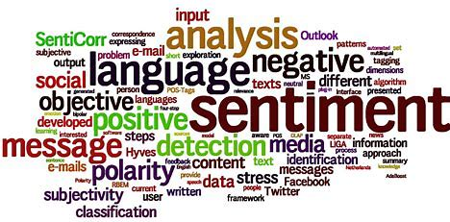
Sentiment Analysis of Financial News using NLTK
Predicting the Sentiment and Emotion analysis of Tweets

Slide 4
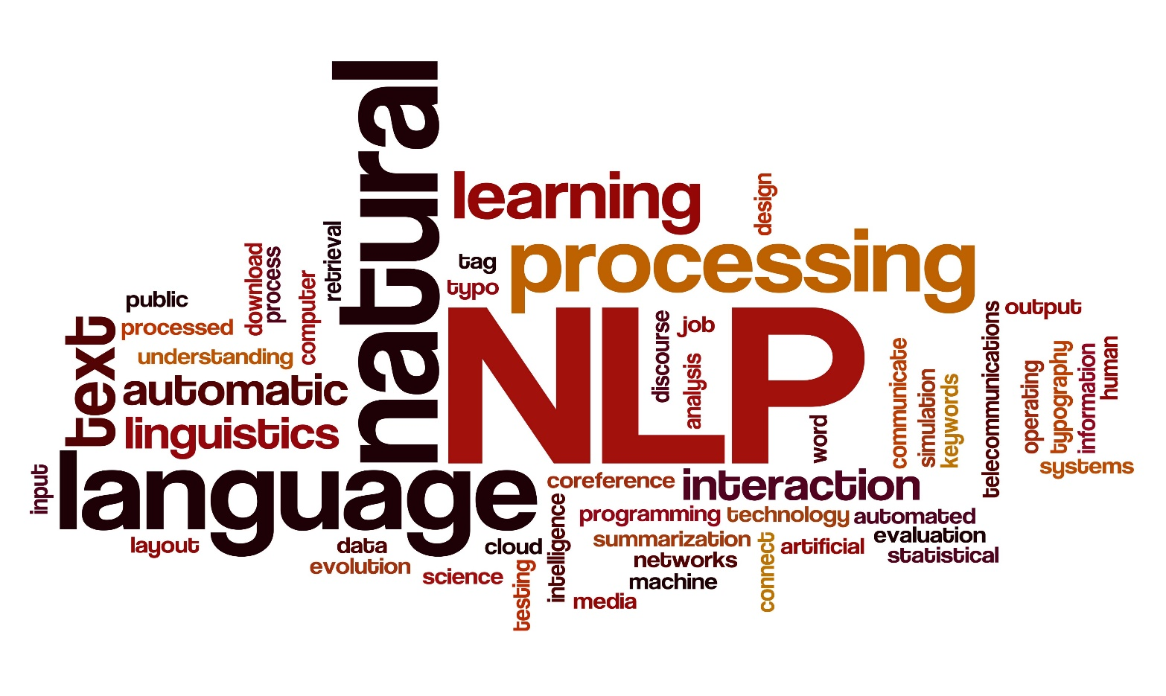
nlp:- Natural language processing (NLP) is a subfield of linguistics, computer science, and artificial intelligence concerned with the interactions between computers and human language, how to program computers to process and analyze large amounts of natural language data.

Slide 5
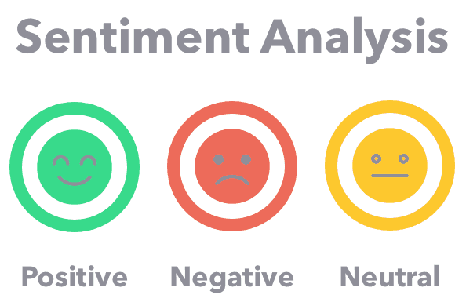

What is Sentiment Analysis ?
Emotion and Sentiment analysis are two related but distinct fields of natural language processing.
Sentiment analysis is the use of NLP, text analysis, computational linguistics, and biometrics to systematically identify, extract, quantify and study affective states and subjective information. It segments textual data into three distinct sentiments (positive, negative or neutral).
Emotional analysis is a more sophisticated solution that digs deeper into specific emotions and helps turn insights into action. It segments comments into 6 so-called primary emptions (joy, positive, surprise, fear, sadness, anger and disgust).

Slide 6
ABOUT DATASET.
This dataset is downloaded from Kaggle.
This dataset contains a csv file
This dataset contains 1csv file(24970,9)

Slide 7
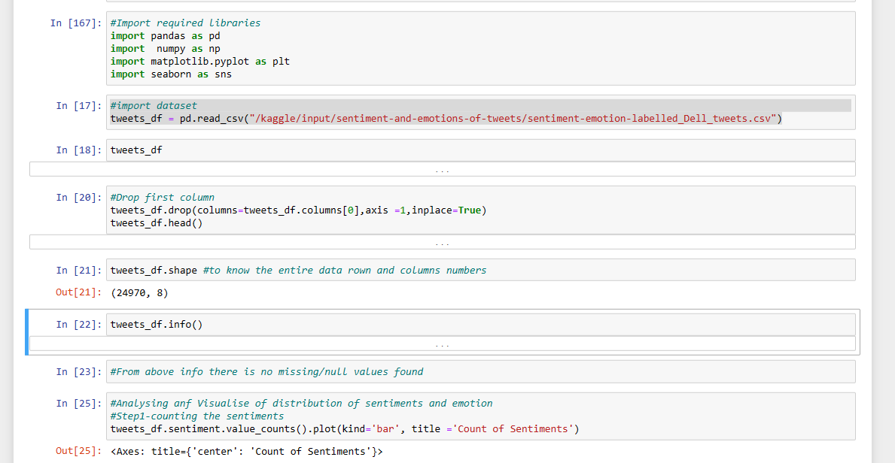
Basic operations on dataset
Loaded the dataset
Checked Shape of the dataset
Understood the Attributes of the dataset
Analysed the Summary of dataset
Checked for Null values
Dropped Null values, if any
Checked for duplicates
Dropped duplicates if any

Slide 8
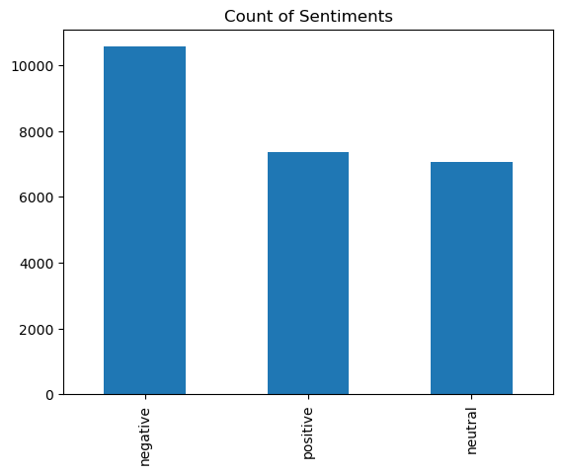
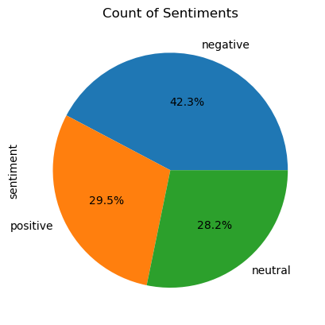
Target Attribute with three classes of sentiment
The sentiment of Tweets for “@dell” are classified into
three class types and their presence in the dataset
is distributed and depicted in the Plots below:

Slide 9
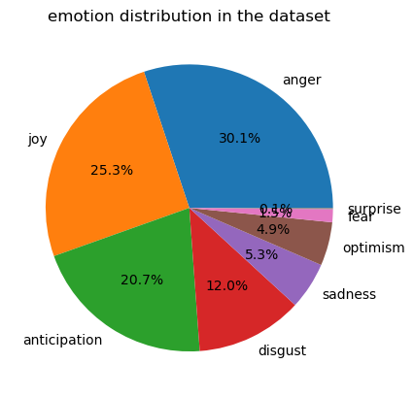
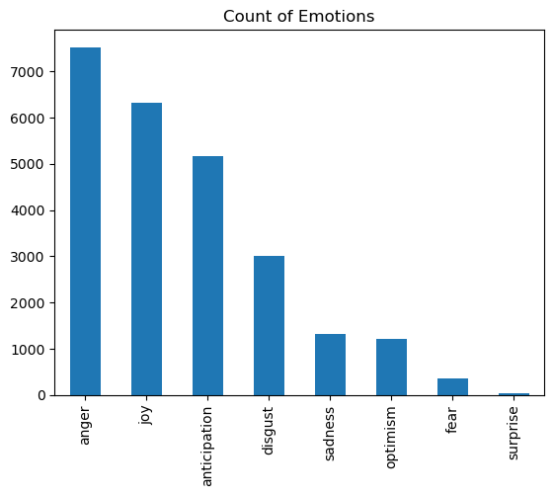
Target Attribute with six classes of Emotion
The Emotion of Tweets @dell are classified into
6 class types and their presence in the dataset
is distributed and depicted in the Plots below:

Slide 10
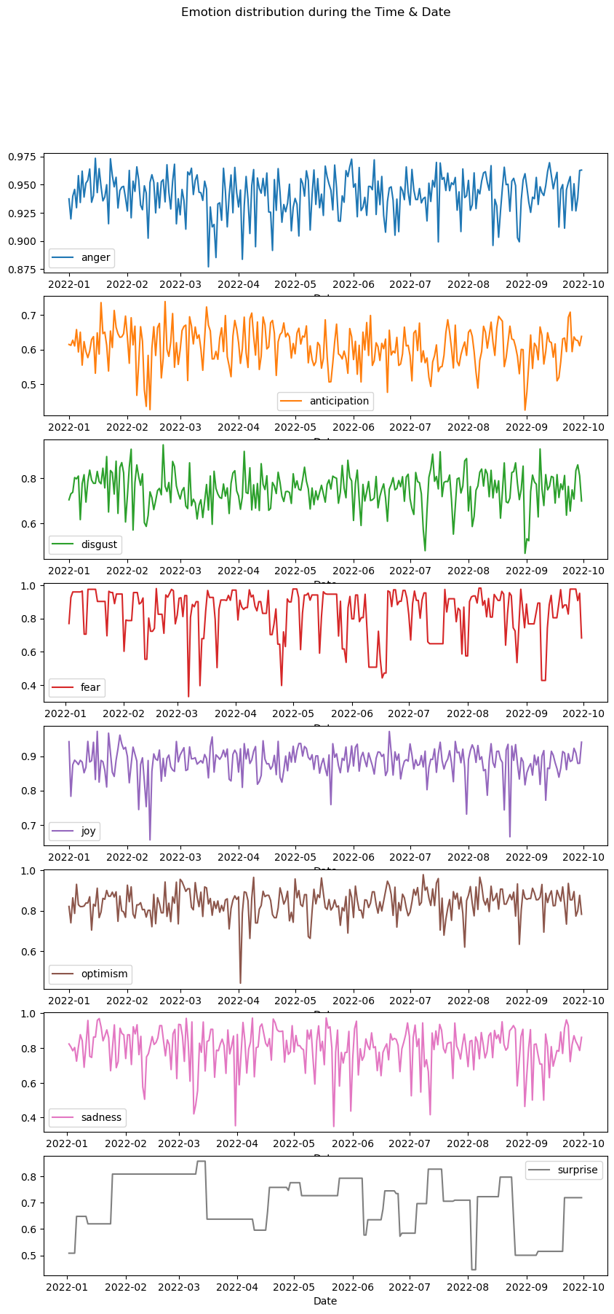
Emotion & sentiment analysis with respect to time & date

Slide 11
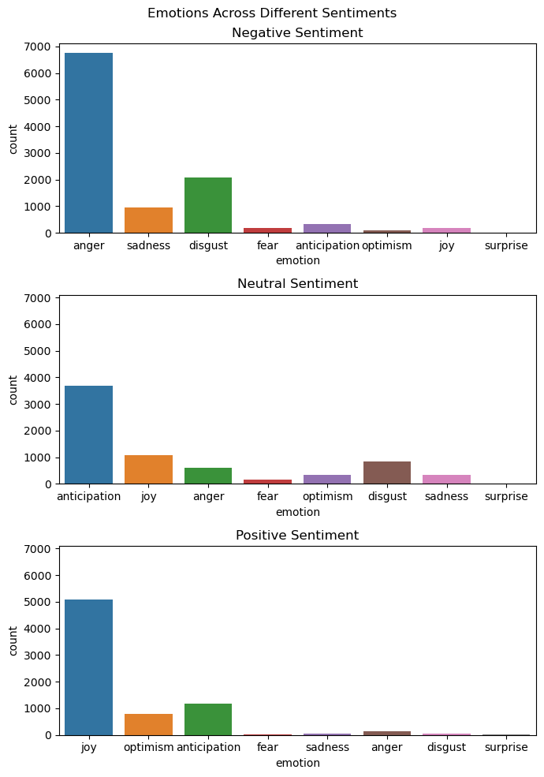
Visualize emotions for different sentiments of tweets.
Negative Tweets are higher across all the quarters.

Slide 12
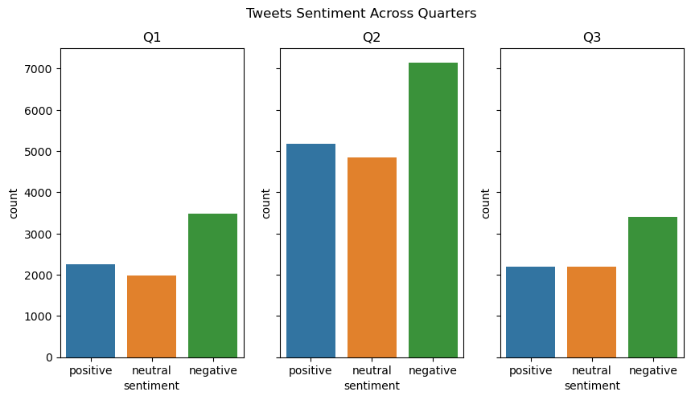
Examine sentiments and emotions across financial quarters (Q1 to Q3) “total number of tweets spiked during the second quarter”

Slide 13
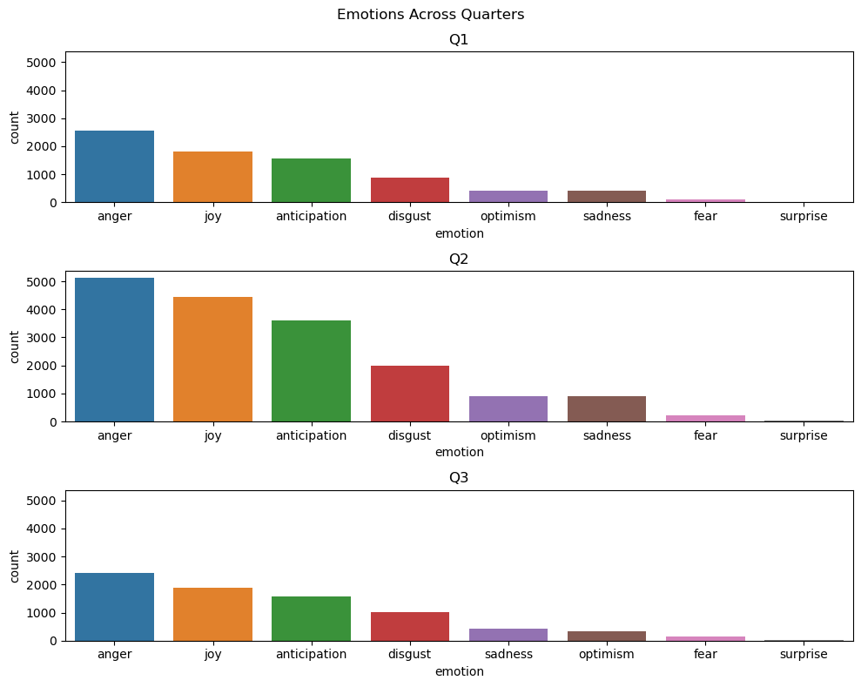
Visualize emotions across quarters

Slide 14
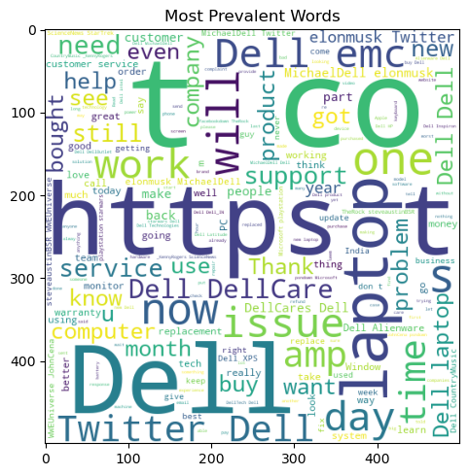
conclusion
As expected,: 'anger' dominates the show, as most of the tweets show negative sentiment. So here is a human behavioral lesson:
People respond more to negative stimuli, that's called negative bias.
For example: How often you read or say, "My laptop's fan has got too noisy", but we hardly mention it when it is working as it should. Got my point!

Slide 15

Thank you!
LAVANYARK1242@GMAIL.COM
https://github.com/lavanya-ramakrishna24/lavanyark.git

